Slide 1
Teachable Machine Lesson
Ismaila Sanusi
School of Computing, University of Eastern Finland
11.08.2021

Slide 2

Overview
How does artificial intelligence (AI) classify data?
The students will explore Teachable Machine, machine learning concept, classification, and societal impact.

Slide 3
Definition
Machine Learning: Ability for computers to learn without being explicitly programmed
Supervised Learning: A type of machine learning where algorithms learn from labeled data
Decision Trees: A type of supervised machine learning where data is split according to a certain parameter

Slide 4
Teachable Machine Warm Up (10 minutes)
Goal: Students will be introduced to Teachable Machine
Divide students into groups.
Go to teachablemachine.withgoogle.com
Click Get Started
Click Image Project
Training Time
Can Teachable Machine know that you and your partner are different people?
Redefine Class 1 as the first person’s name
Redefine Class 2 as the second person’s name
Demonstration
Click Webcam and take 20 images of yourself under Class 1 (redefined as your name)
Note: You must allow webcam access

Slide 5
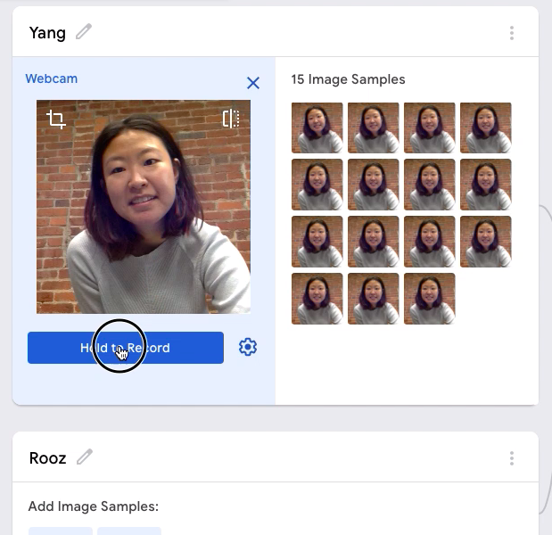
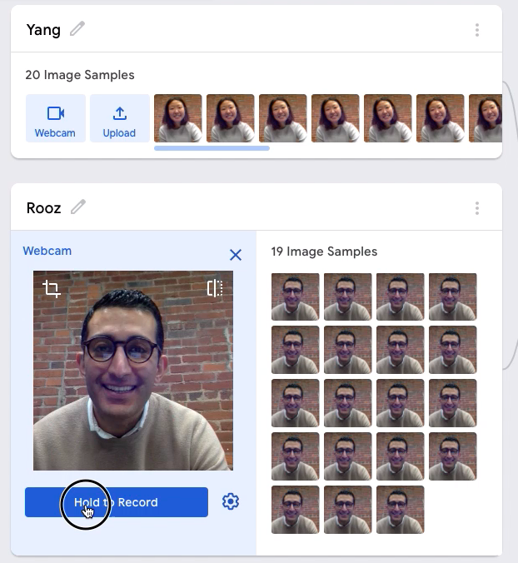
Take 20 images of a second person under Class 2 (redefined as your volunteer’s name)

Slide 6
Fish Classification Game – Students Learn (15 minutes) Goal: Students will learn about classification by coming up with decision rules for poisonous/non-poisonous fish.
Computers are not required for this unplugged portion of the lesson
We gave Teachable Machine two sets of data and told it which belonged in which category. Was this supervised or unsupervised learning? Why?
Supervised learning. We labeled the data and told the machine which data set belonged to which class. So the machine could predict the category of new data.
Each student should pick the Fish Classification Handout
Ýou are tasked with classifying fish as poisonous or non-poisonous. Some physical characteristics of the fish determine which category it falls into.
What is your hypothesis?
Take your pencils and the test data (last page of the Handout).
Students should observe the test data and make predictions on whether these new fish are poisonous or non-poisonous based upon their hypothesis.

Slide 7
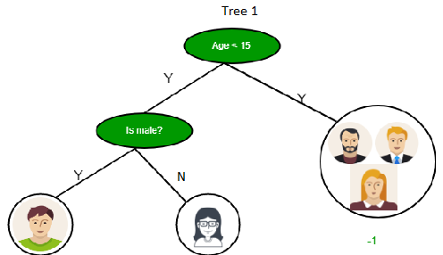
Decision tree sample

Slide 8

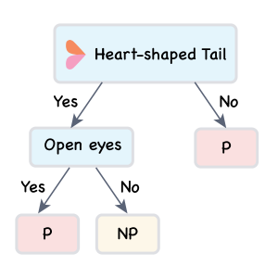

A poisonous fish
A regular fish

Slide 9
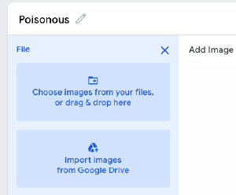
Fish Classification Game – Machines Learn (10 minutes)
Goal: Students will test their theories with Teachable Machine.
Start an image project
Training Time
Can Teachable Machine determine which fish are poisonous and which are not poisonous?
Create Class 1 as the poisonous
Create Class 2 as the non-poisonous
Upload images using the “upload’ button for each class
https://drive.google.com/drive/folders/1iESTXikegcEBJVo-iBP9Ql5RhKF5nkCs?usp=sharing
Choose uploading from your local drive or from Google Drive
Train your model
Click Train
Test

Slide 10
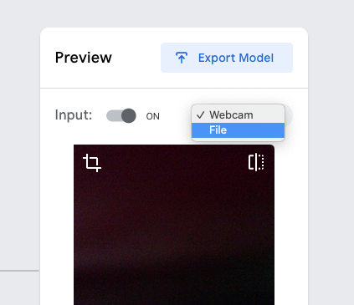
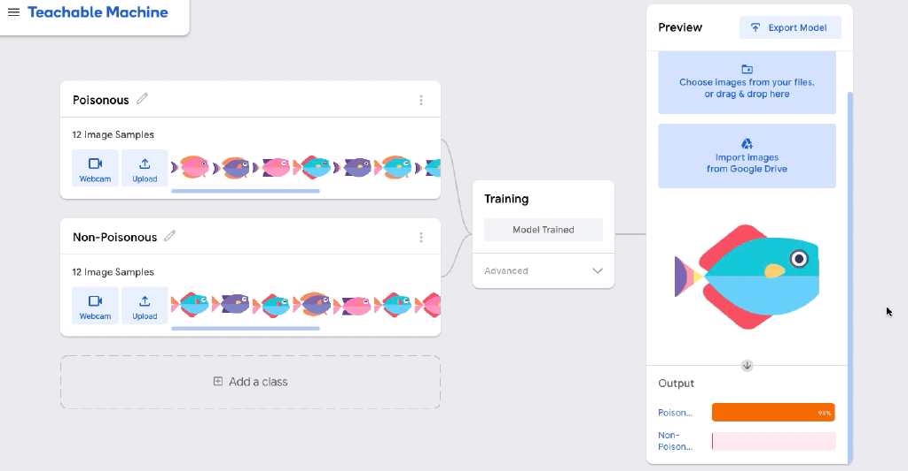
Testing new fish with the model!
Evaluate the results
How successful is Teachable Machine in recognizing which fish are poisonous and non-poisonous?
Sometimes the model gets Fish 4 wrong. Use this opportunity to examine the training samples and think about why Fish 4 is particularly hard for the model.
Use the "File" option to upload

Slide 11
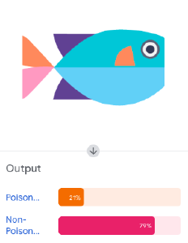
Discussion
It could be that Fish 4’s blue body color is less represented in the poisonous pool, whereas Fish 2 is well represented among the non-poisonous, meaning there are many others look similar to Fish 2.
Additionally, the training set is very small (just 12 images!) which makes recognizing patterns harder and the model’s guesses less accurate.
The algorithm incorrectly says Fish 4 is non-poisonous

Slide 12
Tie In & Closing (10 minutes) Goal: Students review and evaluate
Today we learned about machine learning by first trying classification ourselves then training a machine model to do the same.
Humans and machines learn by recognizing patterns. Just as you all learn by a teacher correcting your math, machines are also teachable.
For instance, supervised machine learning is akin to learning by example: the computer is provided with a data set containing labels that act as answers. Over time the machine can essentially “learn” to differentiate between those labels to produce the correct outcome.
What other applications do you think use AI in this way in your everyday world?
What applications could you see for the future using supervised learning and classification?

Slide 13
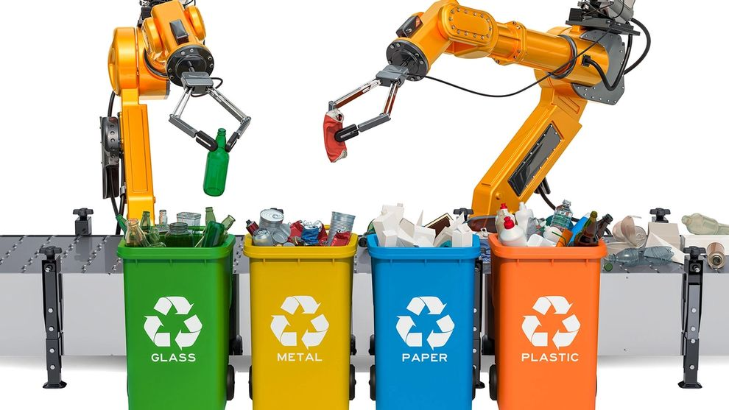

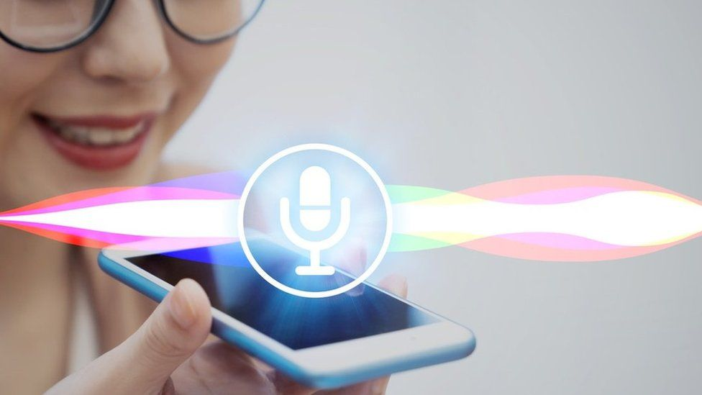

What other applications do you think use AI in this way in your everyday world? Voice assistants such as Alexa or Siri Sorting spam and non-spam emails
What applications could you see for the future using supervised learning and classification?
Classifying surrounding for self-driving cars
Identifying tumors in X-Rays
Sorting recycling from trash
Detecting fraudulent transactions on credit cards
Identifying plants by taking photos

Slide 14


